Slide 1
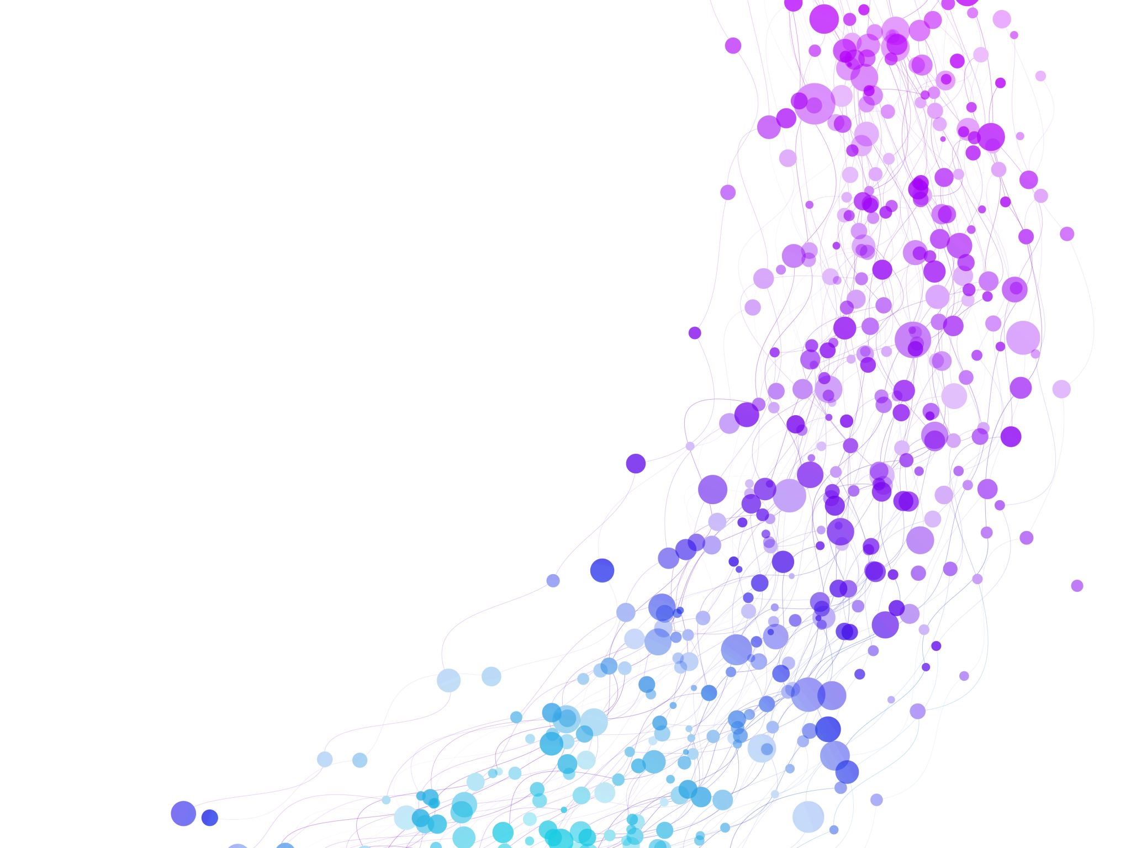


Evaluate Time & Space Complexity Session No.: 3 Course Name: Data Strucutres Course Code: R1UC308B Instructor Name: Dr. Gaurav Agarwal Duration: 50 mins Date of Conduction of Class: 22 Aug 2025

Slide 2

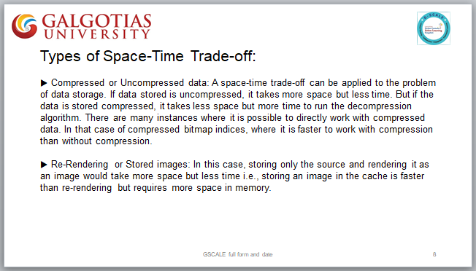
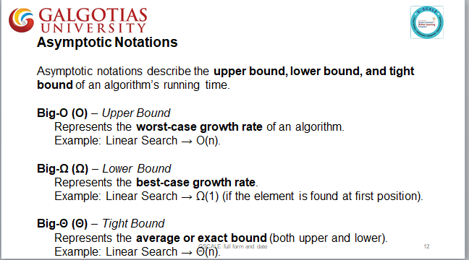
Review

Slide 3

Pre-Class Assessment
[2-mins]

Slide 4

[1-mins]
How to evaluate time and space complexity of an algorithm?

Slide 5
Learning Outcomes
[2-mins]
By the end of this session, You will be able to:
Explain the importance of time and space complexity in evaluating algorithm efficiency.
Calculate the time and space complexity of given algorithms using asymptotic analysis.

Slide 6
Session Outline
Time and space complexity
Evaluate Time & Space complexity
Provide hands-on activities and reinforce learning through an interactive WooClap and WooFlash tools.

Slide 7
Common Time Complexities
O(1) : Constant time (e.g., accessing an array element).
O(log n) : Logarithmic time (e.g., Binary Search).
O(n) : Linear time (e.g., Linear Search).
O(n log n) : Efficient sorting (e.g., Merge Sort, Quick Sort ).
O(n²) : Quadratic time (e.g., Bubble Sort, Selection Sort).
O(2ⁿ) : Exponential time (e.g., recursive Fibonacci).

Slide 8
General rules to help us determine the running time of an algorithm.
Loops:
for( i=1; i<=n; i++)
break; //constant time
Total Time = c 1 → O(1)
Loops:
for( i=1; i<=n; i++) //Executes n times
sum=sum+2; //constant time
Total Time = c x n → O(n)

Slide 9
General rules to help us determine the running time of an algorithm.
Nested Loops:
for( i=1; i<=n; i++) //Outer loop Executes n times
for( j=1; j<=n; j++) //Executes n times
sum=sum+2; //const time
Total Time = c x n x n → O(n²)

Slide 10
General rules to help us determine the running time of an algorithm.
Consecutive Statements:
K = k-1; //Constant time
for( i=1; i<=n; i++) //Executes n times
sum=sum+2; //constant time
for( i=1; i<=n; i++) //Outer loop Executes n times
for( j=1; j<=n; j++) //Executes n times
m=m-2; //constant time
Total Time = c1 + c2 x n + c3 x n x n → O(n²)

Slide 11
General rules to help us determine the running time of an algorithm.
If-then-else:
If(length()==0) //constant time
return false; //constant time
else
{
for(int n=0; n<length(); n++) //Executes n times
if( !Arr[n].equals(Arr2[n])) //constant time
return false; //constant time
}
Total Time = c1+ c2 + (c3+c4) x n → O(n)

Slide 12
General rules to help us determine the running time of an algorithm.
Logarithmic:
for( i=1; i<=n; )
i=i*2; 2,4,8,…→ 2^{n} = m
Total Time = O(log m)
Logarithmic:
for( i=n; i>=1; )
i=i/2;
Total Time = O(log m)

Slide 13
General rules to help us determine the running time of an algorithm.
Nested Loops:
for( i=1; i<=n; i++) //Outer loop Executes n times
for( j=1; j<=n; j=j*2) //Executes log(n) times
Print(); //const time
Total Time = c x n x log(n) → O(nlog(n))
Nested Loops:
for( i=1; i<=n; i++) //Outer loop Executes n times
for( j=1; j<=n; j=j++) //Executes n times
if ( j%2==1)
break; //const time
Total Time = c x n x 1 → O(n)

Slide 14
General rules to help us determine the running time of an algorithm.
Square Root:
for( i=1; i x i<=n; i++ )
print();
Total Time = O(sqrt(n))
Cube Root:
for( i=1; i x i x i<=n; i++ )
print();
Total Time = O(CubeRoot(n))

Slide 15
General rules to help us determine the running time of an algorithm.
Multiple Loops:
for( j=1; j<N; j++) //Executes N times
print(); //const time
for( i=1; i<M; i++) //Executes M times
print(); //const time
Total Time = c x N x M → O( N+M )
Space Complexity = O(1)

Slide 16
Space Complexity
The term Space Complexity is misused for Auxiliary Space at many places.
Following are the correct definitions of Auxiliary Space and Space Complexity. Auxiliary Space is the extra space or temporary space used by an algorithm. Space Complexity of an algorithm is the total space taken by the algorithm with respect to the input size. Space complexity includes both Auxiliary space and space used by input. For example, if we want to compare standard sorting algorithms on the basis of space, then Auxiliary Space would be a better criterion than Space Complexity. Merge Sort uses O(n) auxiliary space, Insertion sort, and Heap Sort use O(1) auxiliary space. The space complexity of all these sorting algorithms is O(n) though.
Space complexity is a parallel concept to time complexity.
If we need to create an array of size n, this will require O(n) space.
If we create a two-dimensional array of size n*n, this will require O(n²) space.

Slide 17

Activity-1 (Think – Pair – Share)
[1-mins]
int sumArray(int arr[], int n)
{
int sum = 0;
for (int i = 0; i < n; i++) {
sum += arr[i];
}
return sum;
}
Expected Answer:
Time Complexity → ?
Space Complexity → ?

Slide 18
Set of problems
for( j=1; j<=n; j++) // j<=n
print();
Time Complexity = O( ? )
for( j=1; j<n; j++) // j<n
print();
Time Complexity = O( ? )
If (x%2==0)
print();
Time Complexity = O( ? )

Slide 19
Set of problems
for( j=1; j<=n; j=j+2) // j=j+2
print();
Time Complexity = O( ? )
for( j=1; j * j * j <= n; j++) // j * j * j <=n
print();
Time Complexity = O( ? )
for( j=1; j <= n; j=j * 3) // j =j*3
print();
Time Complexity = O( ? )

Slide 20
Set of problems
for( j=n; j>=1; j=j/x) // j=j/x
print();
Time Complexity = O( ? )
for( j=1; j <= n; j++)
for(i=1; i<=j; i++)
print();
Time Complexity = O( ? )
for( j=1; j <= n; j++)
for(i=1; i<=n; i++)
if (i%2==0)
break;
Time Complexity = O( ? )

Slide 21
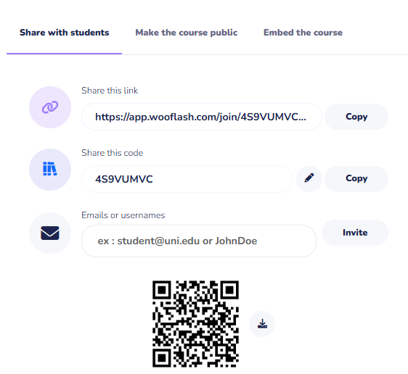
Assessment: WooFlash Quiz

Slide 22
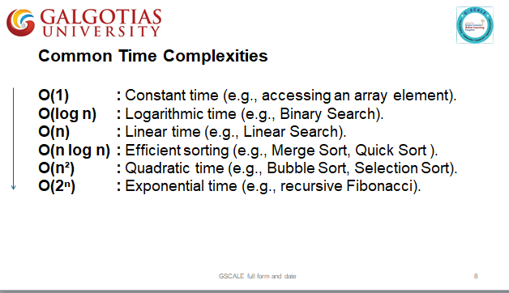
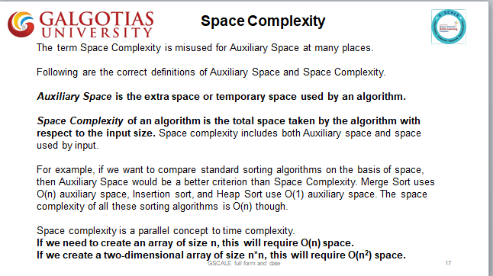
Summary
[1-mins]

Slide 23
[2-mins]
Ensure attainment of LO’s in alignment to the learning activities:
Explain the importance of time and space complexity in evaluating algorithm efficiency.
Calculate the time and space complexity of given algorithms using asymptotic analysis.

Slide 24
[1-min]
Next Session:
Introduction of an Arrays

Slide 25
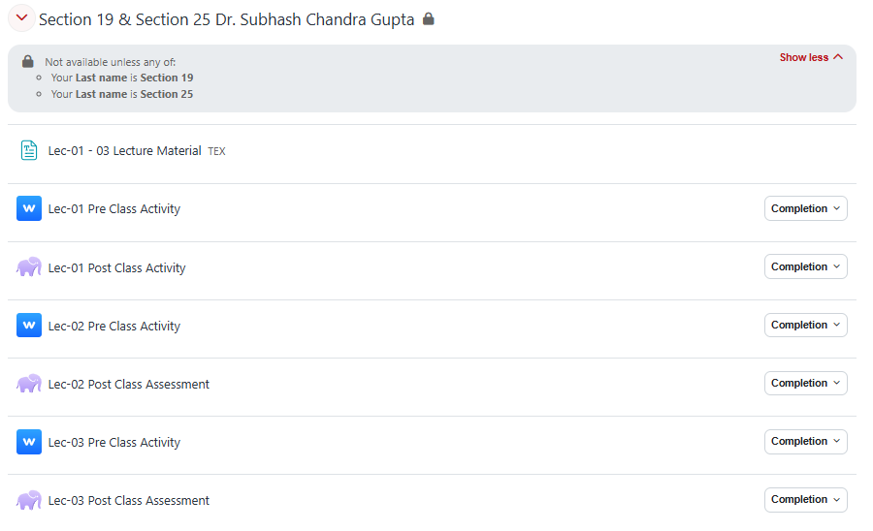
Review and Reflection from students

